Slide 1
Statistics in this lecture is mostly focused on statistical estimation… I did not cover significance testing, hypothesis testing, and only covered confidence intervals minimally
In terms of connection to assignments, students are asked to compute maximum likelihood estimates (MLE) in a few places, but when actually fitting models it is all handled by Scikit-Learn’s fit() function anyway
Most students were able to hand compute MLEs, but a fair number struggled with it even after several times… if you decide to keep MLE and have them do it then I would go slowly through several examples (I go fairly quickly over just one or two
Hypothesis and Significance Testing
It would be very useful to incorporate extended discussion of this, and add it to homeworks
Computing p-values would make utility of the CDF more clear
Should carefully cover assumptions of significance testing (e.g. convergence to limiting distribution of estimator)
They do implement bootstrap on one homework, and compute bootstrap confidence intervals, but we never actually used it on a real problem
Homework Idea Give them data and pose a question that could be answered with a hypothesis test

Slide 2

CSC380: Principles of Data Science
Statistics 1 Xinchen Yu
Acknowledgement: Built on Jason Pacheco, Kwang-Sung Jun, Chicheng Zhang’s slides

Slide 3
Probability and Statistics
Probability provides a mathematical formalism to reason about random events
Knowing the distribution, how can we compute probability of the event of interest? (e.g., two fair dice, P(sum = 3 | X₁ = 1) )
Statistics is centered on data
Fitting models to data (estimation)
E.g., I don’t know the distribution, but I have samples drawn from it. Let’s estimate what the distribution was! ⇒ reverse engineering!
Answering questions from data (statistical inference, hypothesis testing)
Interpretation of data
Statistics uses probability to address these tasks

Slide 4
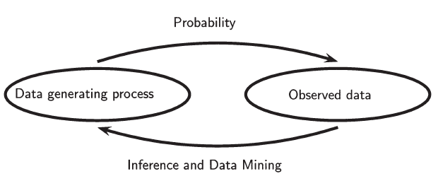
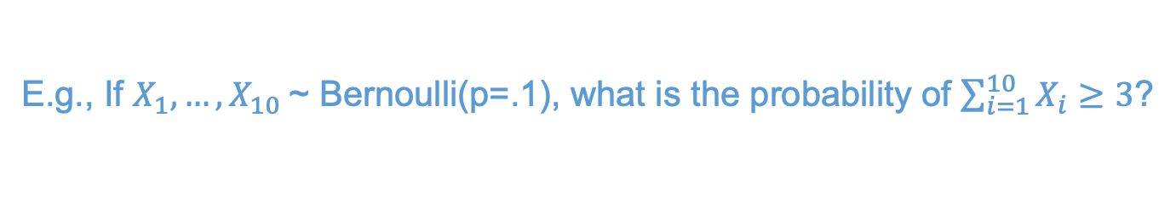
Probability and Statistics
Probability: Given a distribution, compute probabilities of data/events.
E.g., If $X_{1},…,X_{10}$~ Bernoulli(p=.1), what is the probability of $\sum_{i=1}^{10}{X_{i}}≥3$?
e.g., data = outcome of coin flip
Inference / Estimation
E.g., We observed $X_{1},…,X_{10}∈\{0,1\}$. What is the head probability?
Statistics: Given data, compute/infer the distribution or its properties.
[ Source: Wasserman, L. 2004 ]
Notes:
data is generated under the rules of probability.
but usually we are interested in what data generating process.. => election example: we are interested in what’s behind the surveys.
statistics is when you observe data and try to infer what is the data generating process.

Slide 5

Intuition Check
Suppose that we toss a coin 100 times. We don’t know if the coin is fair or biased…
Question 1 Suppose that we observe 52 heads and 48 tails. Is the coin fair? Why or why not?
Question 2 Now suppose that out of 100 tosses we observed 73 heads and 27 tails. Is the coin fair? Why or why not?
Question 3 How might we estimate the bias of the coin with 73 heads and 27 tails?

Slide 6
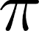
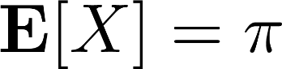
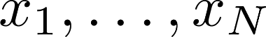
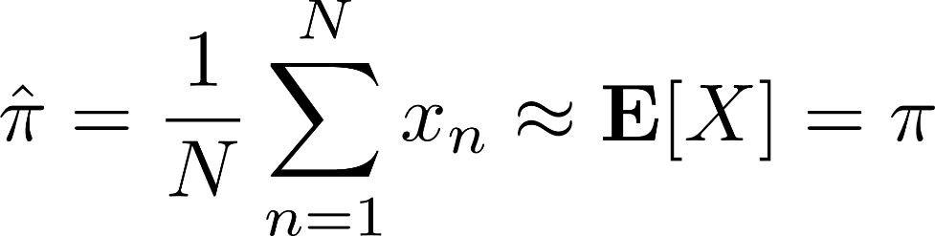
Estimating Coin Bias
We can model each coin toss as a Bernoulli random variable,
$$X \sim Bernoulli\left(π\right) ⇒ p\left(X=x\right)=π^{x}{\left(1−π\right)}^{1−x}$$
Recall that is the coin bias (probability of heads) and that,
Suppose we observe N coin flips , estimate as,
This is called empirical mean or sample mean

Slide 7
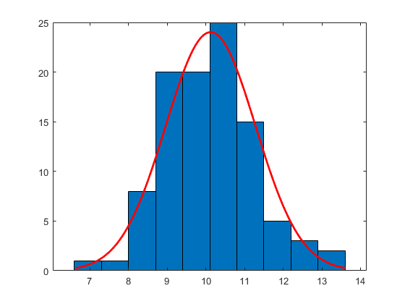
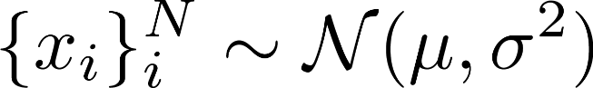
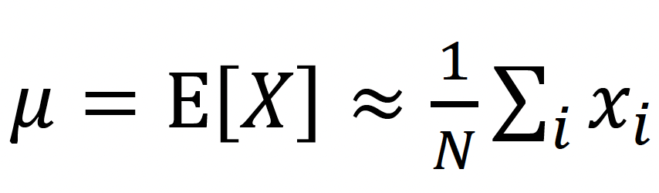
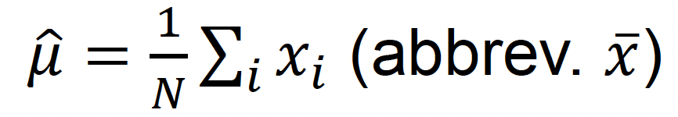
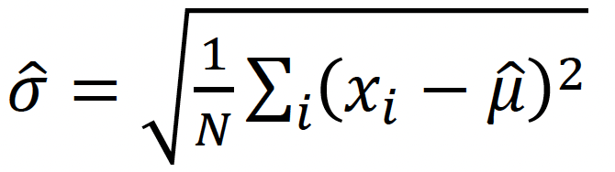
Estimating Gaussian Parameters
Suppose we observe the heights of N students at UA, and we model them as Gaussian:
(A.K.A. Normal)
How can we estimate 𝜇?
Estimate 𝜇 using sample mean
How can we estimate 𝜎?
Estimate 𝜎 using

Slide 8
Limit Theorems: LLN and CLT

Slide 9
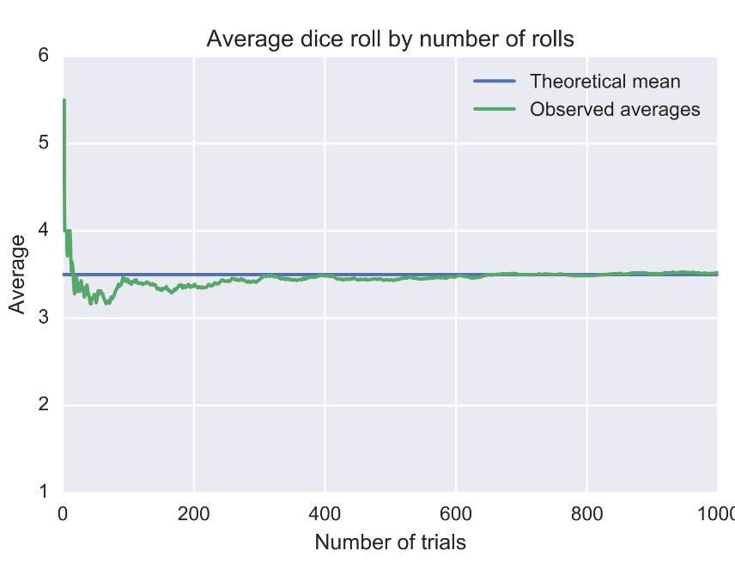
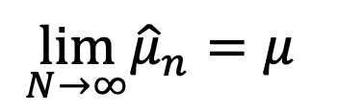
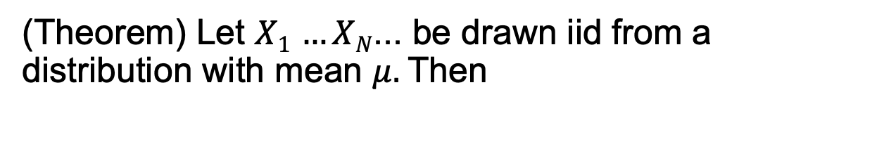
Probability tool: Law of Large Numbers (LLN)
Claim: sample mean converges to the true mean.
(Theorem) Let $X1$ $…XN$... be drawn iid from a distribution with mean $μ.$Then
$$\lim_{N→∞}{\hat{μ}}_{n}=μ⁡$$
This is the law of large numbers
Weak Law: Converges to mean with high probability
Strong Law: Stronger notion of convergence; will converge at all times! (if variance is finite)
Limitation: it does not say how fast it will converge!
Notes:
Motivation: how to know the coin bias? Solution: flip the coin thousands of times, take the proportion of heads, use that for p. But what justifications?

Slide 10
Probability tool: Law of Large Numbers (LLN)
Recall: What is the probability of having two numbers sum to 6?
import numpy as np
for n in [10,100,1_000,10_000,100_000]:
res_dice1 = np.random.randint(1,6+1,size=n)
res_dice2 = np.random.randint(1,6+1,size=n)
res = [(res_dice1[i], res_dice2[i]) for i in range(len(res_dice1))]
cnt = len(list(filter(lambda x: x[0] + x[1] == 6, res)))
print("n=%6d, result: %.4f " % (n, cnt/n))
every time you run, you get a different result
n= 10, result: 0.1000
n= 100, result: 0.1200
n= 1000, result: 0.1350
n= 10000, result: 0.1365
n= 100000, result: 0.1388
n= 1000000, result: 0.1385
n= 10, result: 0.1000
n= 100, result: 0.1900
n= 1000, result: 0.1540
n= 10000, result: 0.1366
n= 100000, result: 0.1371
n= 1000000, result: 0.1394
however, the number seems to converge to 0.138-0.139
If running a large number of trails, result will be very close to expected value.

Slide 11
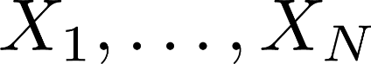
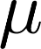
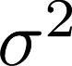
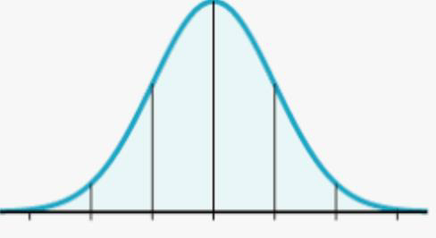
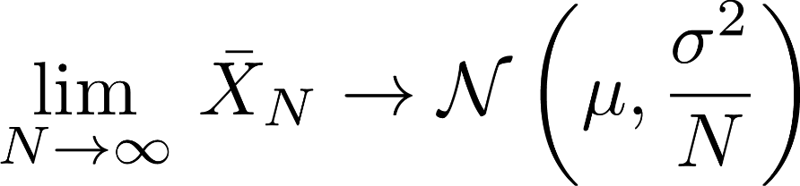
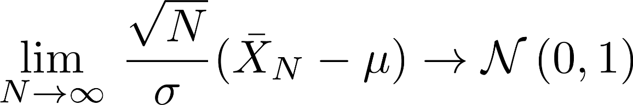
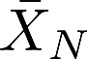
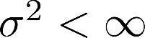
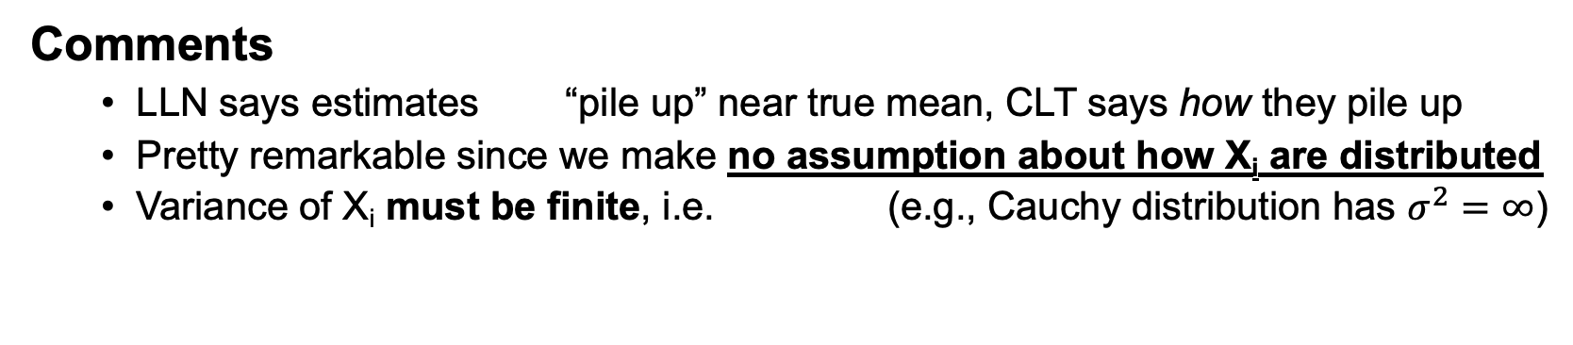

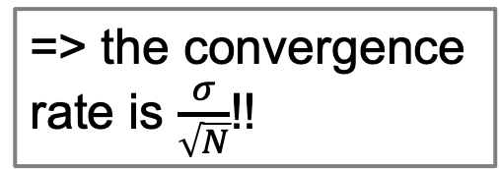
Probability tool: Central Limit Theorem (CLT)
Let be iid with mean and variance then the sample mean ${\overline{X}}_{N}$ approaches a Normal distribution
=> the convergence
rate is $\frac{σ}{\sqrt{N}}$!!
Actually, a mathematically rigorous version is
Comments
LLN says estimates “pile up” near true mean, CLT says how they pile up
Pretty remarkable since we make no assumption about how X_{i} are distributed
Variance of X_{i} must be finite, i.e. (e.g., Cauchy distribution has $σ^{2}=∞$)

Slide 12
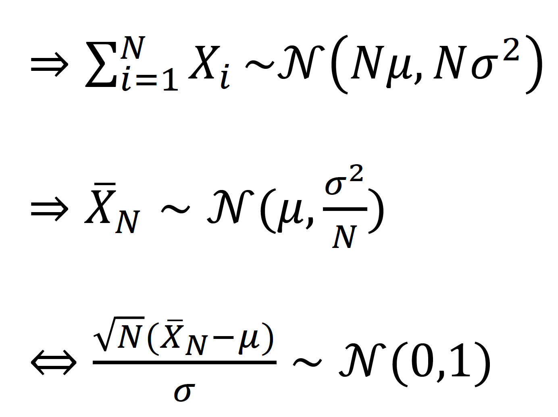
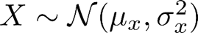
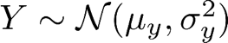
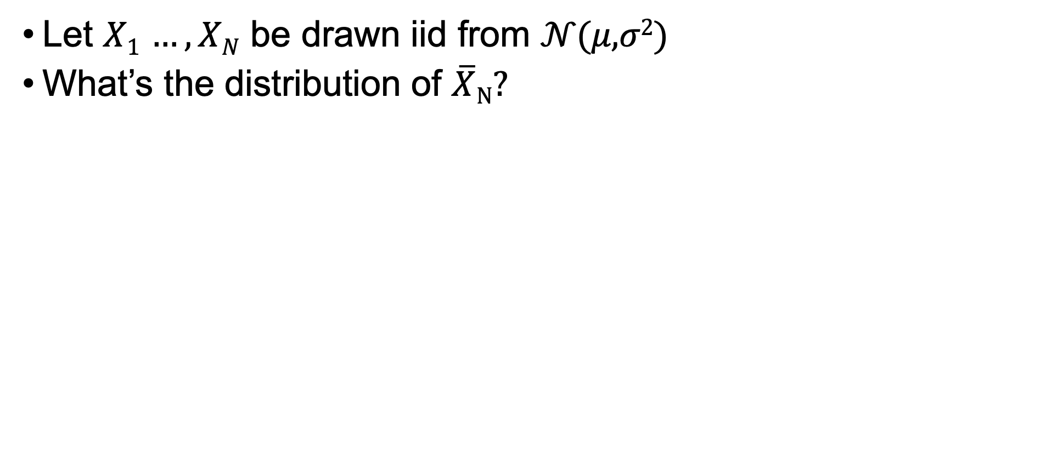
Central Limit Theorem (CLT): sanity check
Let $X1$ $…,XN$ be drawn iid from 𝒩(𝜇,𝜎²)
What’s the distribution of $\overline{X}N$?
Recall: for normal distributions
Closed under additivity:
Closed under affine transformation (a and b constant):
, 𝑋⊥𝑌

Slide 13
Estimation: Classical Statistics

Slide 14
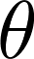
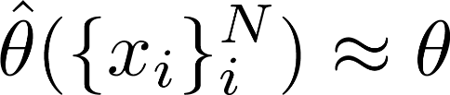
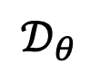
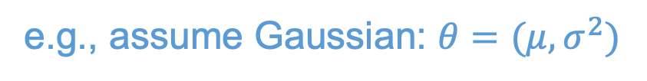
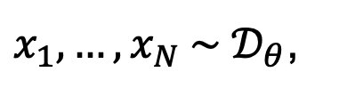
Parameter Estimation
We pose a model in the form of a probability distribution, with unknown parameters of interest ,
$$𝒟_{θ}$$
e.g., assume Gaussian: $θ=(μ,σ^{2})$
Observe data, typically independent identically distributed (iid),
$$p\left(X_{1}=x_{1},…,X_{N}=x_{n}\right)=p\left(X_{1}=x_{1}\right)⋯p(X_{N}=x_{N})$$
i.i.d.
$x_{1}, …,x_{N} \sim 𝒟_{θ}$,
Compute an estimator to estimate parameters of interest,
Many different types of estimators, each with different properties
Notes:
a collection of random variables is independent and identically distributed if each random variable has the same probability distribution as the others and all are mutually independent.

Slide 15
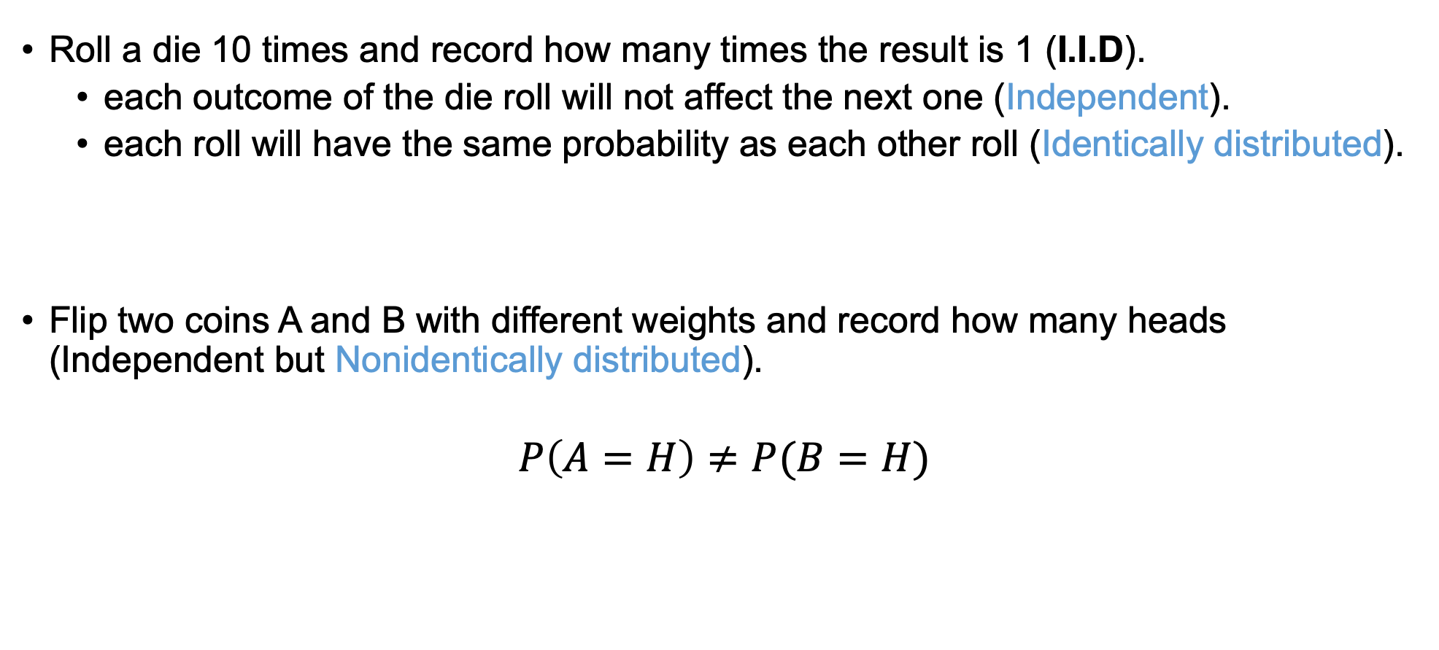
Examples: I.I.D. and Non-I.I.D.
Roll a die 10 times and record how many times the result is 1 (I.I.D).
each outcome of the die roll will not affect the next one (Independent).
each roll will have the same probability as each other roll (Identically distributed).
Flip two coins A and B with different weights and record how many heads (Independent but Nonidentically distributed).
$$P\left(A=H\right)≠P(B=H)$$

Slide 16
Examples: Non-I.I.D.
Dependent identical distribution
First coin (A): fair coin
Second coin (B):
if A=H, throw an unfair coin P(H) = ¼, P(T) = ¾
If A=T, throw an unfair coin P(H) = ¾ , P(T) = ¼
P(A=H)=P(B=H) but A and B are not independent (prove it!)
In general, i.i.d. is necessary to have estimators close to the true parameter
(joint probability table)
 | B=H | B=T
A=H | 1/8 | 3/8 | 1/2
A=T | 3/8 | 1/8 | 1/2
 | 1/2 | 1/2

Slide 17
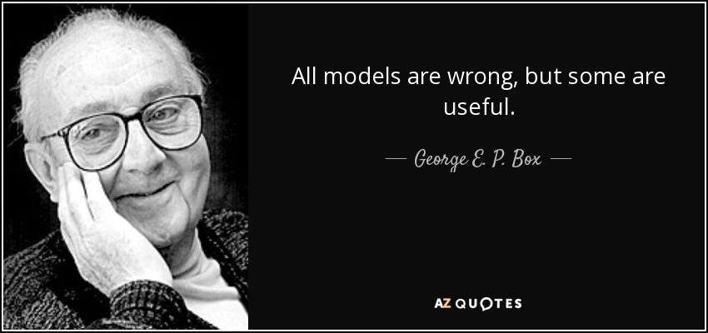
Models
In the previous example, we assumed that the heights follow a normal distribution.
Does it?
There are ways to check if one model is better than the other (will be covered much later)

Slide 18
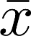
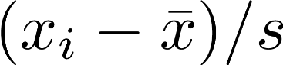
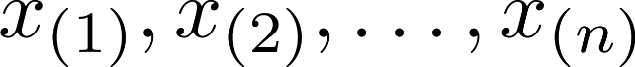
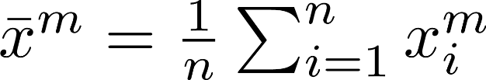
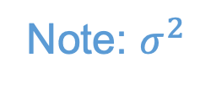
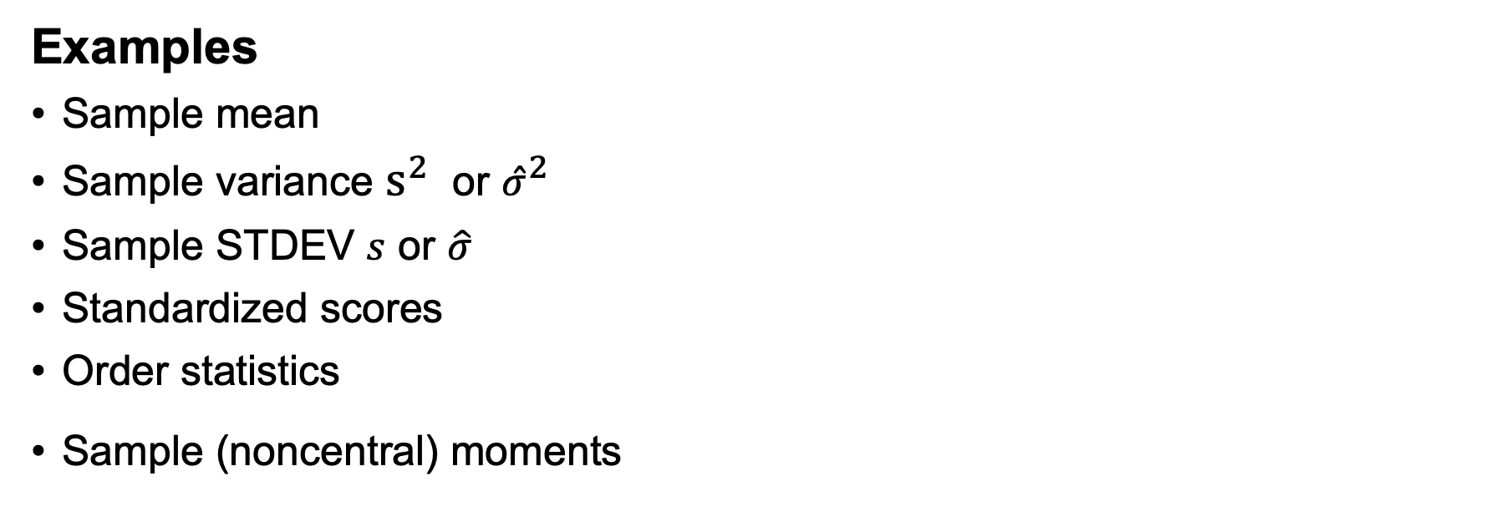
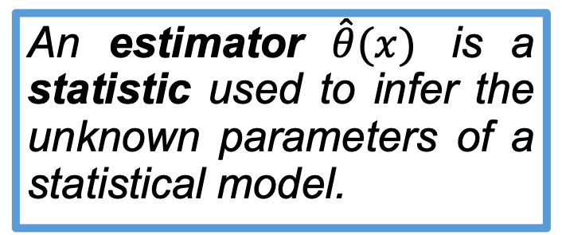
Definitions
A statistic is a function of the data that does not depend on any unknown parameter.
Examples
Sample mean
Sample variance $s^{2}$ or ${\hat{σ}}^{2}$
Sample STDEV $s$ or $\hat{σ}$
Standardized scores
Order statistics
Sample (noncentral) moments
An estimator $\hat{θ}(x)$ is a statistic used to infer the unknown parameters of a statistical model.
Note: $σ^{2}$
Q: Gaussian distribution with unknown mean and variance.
Which of these are estimators?

Slide 19
Definitions
A statistic is a function of the data that does not depend on any unknown parameter.

Slide 20
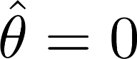
Intuition Check
Suppose that we toss a coin 100 times. We observe 52 heads and 48 tails…
Question 1 I define an estimator that is always , regardless of the observation. Is this an estimator? Why or why not?
Question 2 Is the estimator above a good estimator? Why or why not?
Question 3 What are some properties that could define a good estimator?

Slide 21
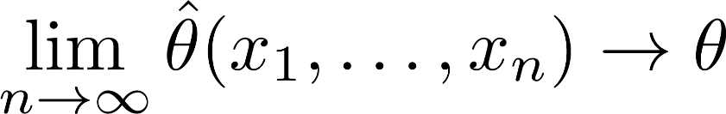
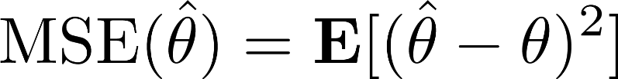

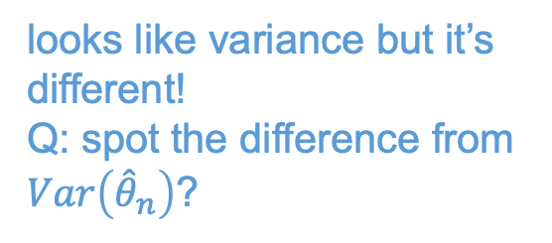
Two Desirable Estimator Properties
Consistency (asymptotic notion) Given enough data, the estimator converges to the true parameter value
Q: Is sample mean a consistent estimator for $μ$?
Yes. The variance of sample mean $\overline{X}N$decreases to 0 as we increase the sample size N.
Efficiency (nonasymptotic notion) It should have low error with finite n, e.g.
n
n
looks like variance but it’s different!
Q: spot the difference from $Var\left({\hat{θ}}_{n}\right)$?
Mean squared error should be small

Slide 22
Two Desirable Estimator Properties
consistent but not as efficient
MSE
(mean squared error)
efficient for small n but not consistent
efficient and consistent
n (sample size)

Slide 23
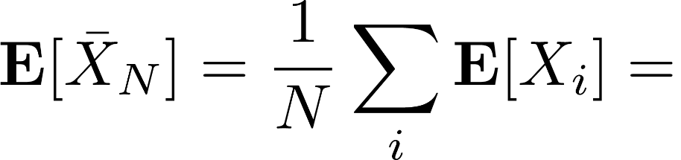
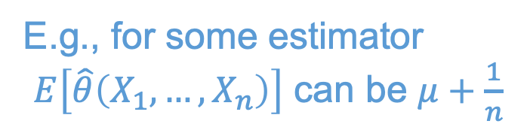
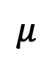
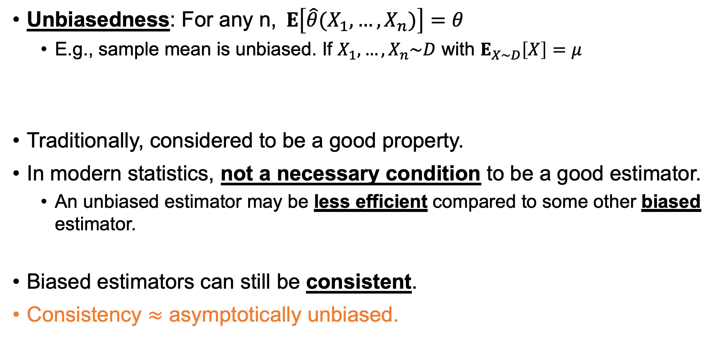
Another Properties of estimators
Unbiasedness: For any n,$E\left[\hat{θ}(X_{1},…, X_{n})\right]=θ$
E.g., sample mean is unbiased. If $X_{1},…,X_{n}\sim D$ with $E_{X\sim D}\left[X\right]=μ$
Traditionally, considered to be a good property.
In modern statistics, not a necessary condition to be a good estimator.
An unbiased estimator may be less efficient compared to some other biased estimator.
Biased estimators can still be consistent.
Consistency $≈$ asymptotically unbiased.
$$μ$$
E.g., for some estimator $E\left[\hat{θ}\left(X_{1},…,X_{n}\right)\right]$ can be $μ+\frac{1}{n}$

Slide 24
CSC380: Principles of Data Science
Statistics 2 Xinchen Yu
Acknowledgement: Built on Jason Pacheco, Kwang-Sung Jun, Chicheng Zhang’s slides

Slide 25
Following slides cover likelihood function and maximum likelihood estimates
Could benefit from a slower introduction, and more intuition / examples, on what exactly the likelihood function measures
None of the students in my lecture had taken a course in optimization… their knowledge of optimization was limited to what was learned in calculus… may want to cover the basics of optimization (e.g. define convexity / concavity, stationary points, difference between local / global optima)
I would have a brief discussion of gradient ascent, but don’t have to go into too many details since they won’t actually implement it… just the concepts

Slide 26


Intuition Check
Suppose that we toss a coin 100 times. We observe 73 heads and 27 tails…
Question Let be the coin bias (probability of heads). What is a more likely estimate? What is your reasoning?
A: , strong preference for heads
B: , fair coin (we observed unlucky outcomes)
Likelihood (informally) Probability/density of the observed outcomes from a particular model

Slide 27



Likelihood (Intuitively)
Suppose we observe N data points from a Gaussian model 𝒩(𝜇,𝜎²), and wish to estimate both 𝜇 and 𝜎².
Say we only need to choose from the following three Gaussians…
High Likelihood
Low Likelihood (mean)
Low Likelihood (variance)
Likelihood Principle: Given a statistical model, the likelihood function describes all evidence of a parameter that is contained in the data.

Slide 28



Likelihood Function
Suppose , then what is the joint probability over N independent identically distributed (iid) observations ?
what appears after ; are parameters, not random variables.
We call this the likelihood function, often denoted $ℒ_{N}(θ)$
It is a function of the parameter , the data are fixed
Describes how well parameter describes data (goodness of fit)
How could we use this to estimate a parameter ?

Slide 29

Maximum Likelihood
Maximum Likelihood Estimator (MLE) as the name suggests, maximizes the likelihood function.
Question How do we find the MLE?
closed-form
iterative methods

Slide 30



Finding the maximum/maximizer of a function
Example: Suppose $f\left(θ\right)=−aθ^{2}+bθ+c$ with $a>0$
It is a quadratic function.
=> finding the ’flat’ point suffices
Compute the gradient and set it equal to 0
$$f^{′}\left(θ\right)=−2aθ+b$$
=> $θ=\frac{b}{2a}$
Closed form!
Q: Does this trick of grad=0 work for other functions?
Yes, concave functions!
Roughly speaking, functions that curves down only, never upwards
(gradient illustration)

Slide 31



Finding the maximum/maximizer of a function
What if there is no closed form solution?
Iterative methods for concave functions
=> Will find the global maximum
for nonconcave,
=> usually find a local maximum but could also get stuck at stationary point.
Example: $f\left(θ\right)=\frac{1}{2}x(ax −2\log\left(x\right)+2)$
$$f^{′}\left(θ\right)=ax −log⁡(x)$$
No known closed form for $ax=\log\left(x\right)$
Iterative methods:
Gradient ascent (or descent if you are minimizing)
Newton’s method
Etc. (beyond the scope of our class)
Q: find the local maxima and global maximum

Slide 32



Maximum Likelihood
Maximizing log-likelihood makes the math easier (as we will see) and doesn’t change the answer (logarithm is an increasing function)
Derivative is a linear operator so,
One term per data point Can be computed in parallel (big data)
Taking log, it becomes a quadratic function!

Slide 33






Maximum Likelihood: Bernoulli
[ Source: Wasserman, L. 2004 ]
Example N coin tosses with $X_{1},…,X_{n}\sim Bernoulli(p)$. We don’t know the coin bias $p$. The likelihood function is,
where . The log-likelihood is,
Likelihood function for Bernoulli with n=20 and heads
Set the derivative of to zero and solve,
Maximum likelihood is equivalent to sample mean in Bernoulli
⇒ this showcases how MLE is aligned to our intuition!

Slide 34








Maximum Likelihood: Gaussian
Example Let with parameters$θ=(μ,σ^{2})$ and the likelihood function (ignoring some constants) is:
Exercise: Show that
$$\sum_{i}{{\left(X_{i}−μ\right)}^{2}}=nS^{2}+n{\left(\overline{X}−μ\right)}^{2}$$
Where and are sample mean and sample variance, respectively.

Slide 35




Maximum Likelihood: Gaussian
Continuing, write log-likelihood as:
Solve zero-gradient conditions:
To obtain maximum likelihood estimates of mean / variance:
$$\hat{μ}=\frac{1}{n}\sum_{i=1}^{n}{X_{i}}$$
$${\hat{σ}}^{2}=\frac{1}{n}\sum_{i}{{\left(X_{i}−\hat{μ}\right)}^{2}}$$

Slide 36
MLE Review: Probability/Density vs Likelihood
The probability/density of data given parameter is mathematically the same object as likelihood of a parameter given data
The difference is the point of view!
From the probabilistic perspective, the parameter is fixed and PMF/PDF is viewed as a function of the possible data
From the statistical perspective, the data is given (thus fixed) and we view likelihood as a function of the parameter.
Statistics is inherently about reverse engineering.

Slide 37
MLE
MLE is a very important tool.
Usually, you write a function that computes log likelihood and then you will use existing libraries (e.g., cvxpy) to find the maximizer (next slide)
There are efforts to develop ‘probabilistic programming’ (next slide)

Slide 38

CVXPY
# Import packages.
import cvxpy as cp
import numpy as np
# Generate data.
m = 20
n = 15
np.random.seed(1)
A = np.random.randn(m, n)
b = np.random.randn(m)
# Define and solve the CVXPY problem.
x = cp.Variable(n)
cost = cp.sum_squares(A @ x - b)
prob = cp.Problem(cp.Minimize(cost))
prob.solve()
# Print result.
print("\nThe optimal value is", prob.value)
print("The optimal x is")
print(x.value)
Not the usual variable, but it is an object specifically designed to work with optimization algorithms.
Cost is not an actual value; it is an object of cvxpy that encodes the operation of $\sum_{i}{{\left({⟨A}_{i,⋅},x⟩ −b_{i}\right)}^{2} }$ as a tree.
Alternative: cp.Maximize
Cvxpy.Problem has many numerical methods to find the optimal solution

Slide 39

Julia: Turing.jl package
aims to do ‘declarative’ programming for probabilistic models, just like SQL in databases!
using Turing
using Optim
@model function gdemo(x)
σ² ~ InverseGamma(2, 3)
m ~ Normal(0, sqrt(σ²))
for i in eachindex(x)
x[i] ~ Normal(m, sqrt(σ²))
end
end
# Create some data to pass to the model.
data = [1.5, 2.0]
# Instantiate the gdemo model with our data.
model = gdemo(data)
# Generate a MLE estimate.
mle_estimate = optimize(model, MLE())
DynamicPPL.Model{typeof(gdemo), (:x,), (), (), Tuple{Vector{Float64}}, Tuple{}, DynamicPPL.DefaultContext}(gdemo, (x = [1.5, 2.0],), NamedTuple(), DynamicPPL.DefaultContext())
ModeResult with maximized lp of -0.07
2-element Named Vector{Float64}
A │
────┼───────
:σ² │ 0.0625
:m │ 1.75
# to access the value
mle_estimate.values[:σ²]

Slide 40




Maximum Likelihood Properties
1) The MLE is a consistent estimator:
Roughly, converges to the true value.
2) The MLE is an asymptotically efficient: roughly, has the lowest mean squared error among all consistent estimators.
3) The MLE is an asymptotically Normal: roughly, the estimator (which is a random variable) approaches a Normal distribution (more later).
4) The MLE is functionally invariant: if is the MLE of then is the MLE of .

Slide 41










Expectation of the Sample Mean
Recall: An estimator $\hat{θ}$ is a RV (Random Variable).
Example Let and estimate be the sample mean,
$$p\left( \hat{θ}\left(X\right)\right)$$
Question What is the expected value of ?
Notation: $X ≔(X_{1},….,X_{N})$
(a) Linearity of Expectation Operator
(b) Mean of Bernoulli RV = p
Conclusion On average (it is unbiased)

Slide 42








Variance of the Sample Mean
Example Let and estimate be the sample mean. Calculate the variance of :
quiz candidate
(a)
(b) Independent RVs
(c) Var(X) = p(1-p) for Bernoulli
In General Variance of sample mean for RV with variance ,
STDEV of sample mean
decreases as $1/\sqrt{N}$
Decreases linearly with number of samples N

Slide 43







Unbiasedness of the Sample Variance?
Recall: Sample mean is an unbiased estimator for the true mean.
How about the sample variance?
Ex. Let be drawn (iid) from any distribution with and,
Source of bias: plug-in mean estimate
Then the sample variance is a biased estimator,
tends to underestimate
Q: is this estimator consistent or not?
Correcting bias yields unbiased variance estimator:
Consistent!
$${\hat{σ}}_{unbiased}^{2}$$
quiz candidate:
show that $E\left[\frac{1}{N}\sum_{i=1}^{N}{{\left(X_{i}−μ\right)}^{2}}\right]$ is unbiased (note $μ=E\left[X_{1}\right]=…=E[X_{N}]$)

Slide 44
CSC380: Principles of Data Science
Statistics 3 Xinchen Yu
Acknowledgement: Built on Jason Pacheco, Kwang-Sung Jun, Chicheng Zhang’s slides

Slide 45


Numpy Background
Often, you have a matrix of data: e.g., movie review score
User \ Movie | Inception | Jurassic park | Batman
A | 5 | 2 | 3
B | 1 | 4 | 2
C | 4 | 3 | 3
D | 1 | 2 | 3
Numpy arrays can be 2d
means $\left(\begin{matrix}1 & 2 & 3 \\ 4 & 5 & 6\end{matrix}\right)$
A = np.array([[1,2,3],[4,5,6]])
A[0,1]
$⟹$ 2
mean(A,0)
$⟹$ array([2.5, 3.5, 4.5])
mean(A,1)
$⟹$ array([2., 5.])
access A[0,1] means 1st row, 2nd column
computes average for each column
computes average for each row
var(A,0), var(A,1) works the same way!

Slide 46

More on Unbiased Estimator
Task: Compare the MSE (mean squared error) of the two variance estimators for N=5.
import numpy as np
import numpy.random as ra
X = ra.randn(10_000,5) # 10k by 5 matrix of $𝒩$(0,1) => 10k random trials
np.mean((var(X,1,ddof=0) - 1)**2)
$⟹$ 0.36310526687176103
np.mean((var(X,1,ddof=1) - 1)**2)
$⟹$ 0.5071783438808787
ddof=0 uses 1/N ddof=1 uses 1/(N-1)
biased version is more accurate! (but recall that it will underestimate)
There is a trade off between bias and variance!!

Slide 47





Bias-Variance Tradeoff
Is an unbiased estimator “better” than a biased one? It depends…
Evaluate the quality of estimate using mean squared error,
MSE for unbiased estimators is just,
MSE
Bias-variance is fundamental tradeoff in statistical estimation
MSE increases as square of bias
Biased estimator can be more accurate than an unbiased one.
Bias squared

Slide 48

Bias-Variance Tradeoff
Suppose an archer takes multiple shots at a target…
Accurate
Precise
Accurate
Not Precise
Not Accurate
Precise
Not Accurate
Not Precise

Slide 49





Bias-Variance Decomposition
quiz candidate
$$E\left[{\left(E\left[\hat{θ}\right]−θ\right)}^{2}\right]$$

Slide 50

Intuition Check
Compare the results of two coin flip experiments…
Experiment 1 Flip 100 times and observe 73 heads, 27 tails
Experiment 2 Flip 1,000 times and observe 730 heads, 270 tails
Question The MLE estimate of coin bias for both experiments is equivalent . Which should we trust more? Why?
Remark The estimate $\hat{θ}(X)$ is a function of random data. So, it is a random variable. It has a distribution.

Slide 51
Announcements
HW2 grades will be out by next Friday.
HW3 will be released next Tuesday

Slide 52
Announcements
Banerjee, Adi
Yokubjonov, Khojiakbar
Fox, Hugh Scott
Maliyagoda, Dilan A
Zhang, Kevin
Bhatia, Aman
Do, Henry T Lu, Richard Jadhav, Aditya
Discussion this week: Upload questions by Friday:
Your name could appear again if your question is not qualified.
Questions not on the lecture itself will not count.
Do not count: logistics, homework, etc.
Next time, you will not be given a second chance.

Slide 53








Confidence Intervals
Informally, find an interval such that we are pretty sure it encompasses the true parameter value.
significance level = failure rate
Given data and confidence find interval such that,
In English the interval contains the true parameter value with probability at least
Intervals must be computed from data: i.e., and
Interval (a,b) is random, parameter is not random (it is fixed)
Usually, you compute an estimator $\hat{θ}$ and then set $a=\hat{θ}−ε_{a}$ and $b=\hat{θ}−ε_{b}$ for a carefully chosen $ε_{a},ε_{b}>0$

Slide 54


Confidence Intervals of the Normal Distribution
Suppose $X_{1},…, X_{n}\sim 𝒩(μ,σ^{2})$ with unknown $μ$ & known $σ^{2}$. Let $\hat{μ}≔\frac{1}{n}\sum_{i}{X_{i}}$.
(Fact 1) $\hat{μ}\sim 𝒩\left(μ, \frac{σ^{2}}{n}\right)$
quiz candidate
(proof)
$$\sum_{i=1}^{n}{X_{i}}\sim 𝒩\left(nμ, nσ^{2}\right)$$
Use this with $X=\sum_{i=1}^{n}{X_{i}}, a=\frac{1}{n}, b=0$.
Recall:
Closed under additivity:
Closed under affine transformation (a and b constant):

Slide 55





Confidence Intervals of the Normal Distribution
Suppose $X_{1},…, X_{n}\sim 𝒩(μ,σ^{2})$ with unknown $μ$ & known $σ^{2}$. Let $\hat{μ}≔\frac{1}{n}\sum_{i}{X_{i}}$.
Terminology: “standard” normal distribution := $𝒩(0,1)$
(Fact 2) If $Z\sim 𝒩(0,1)$,
$$P\left(Z∈[−z,z] \right)=1−2\left(1−Φ\left(z\right)\right)$$
where $Φ\left(z\right)≔P(Z≤z)$ is the CDF of Z. z = 1.96: RHS $≈.95$, 95% confident z = 2.58: RHS $≈.99$,
(Corollary)
$P\left(\hat{μ}∈\left[μ−\frac{zσ}{\sqrt{n}},μ+\frac{zσ}{\sqrt{n}}\right]\right)=1−2\left(1−Φ\left(z\right)\right)$
hints: use the fact $\sqrt{n}\frac{\hat{μ}−μ}{σ}\sim N(0,1)$ . Set $Z≔ \sqrt{n}\frac{\hat{μ}−μ}{σ}$ and use Fact 2.
Gaussians almost do not have tails!
remember: ‘normal algebra’ is very useful
(and will appear in exams)

Slide 56




Confidence Intervals of the Normal Distribution
Suppose $X_{1},…, X_{n}\sim 𝒩(μ,σ^{2})$ with unknown $μ$ & known $σ^{2}$. Let $\hat{μ}≔\frac{1}{n}\sum_{i}{X_{i}}$.
Finally, by our corollary,
$$P\left(\hat{μ}∈\left[μ−\frac{1.96σ}{\sqrt{n}},μ+\frac{1.96σ}{\sqrt{n}}\right]\right)≥0.95$$
$$P\left(\hat{μ}∈\left[μ−\frac{2.58σ}{\sqrt{n}},μ+\frac{2.58σ}{\sqrt{n}}\right]\right)≥0.99$$
note we can switch $\hat{μ}$ and $μ$
$$P\left(μ ∈\left[\hat{μ}−\frac{1.96σ}{\sqrt{n}},\hat{μ}+\frac{1.96σ}{\sqrt{n}}\right]\right)≥0.95$$
This is a confidence bound for the mean $μ$ !!
=> Compute $\left[\hat{μ}−\frac{1.96σ}{\sqrt{n}}, \hat{μ}+\frac{1.96σ}{\sqrt{n}}\right]$. Done!
Q: If $X_{1}, …, X_{n}$ from an arbitrary distribution, can we still use the same method?
Almost yes, if n is large enough! => central limit theorem (see later).

Slide 57


Warning
Question How should we interpret a confidence interval (e.g. 95%)?
This is NOT about the randomness of $θ$
Hint Think about what is random and what is not…
Wrong If someone reveals $θ$ when we have exactly the same data, then $θ$ will be in the interval with probability at least 95%
the moment you compute the interval with the data, whether or not $θ$ is in the interval is determined.. you just don’t know it!
This is commonly misinterpreted

Slide 58


Caveat: interpreting confidence intervals
Recommended point of view:
Assume: Heights of UA students follow a normal distribution $𝒩\left(μ,1\right)$ with unknown $μ$
Fork m parallel universes. For each universe $u∈\{1,2,…,m\}$,
Subsample $n$ UA students randomly, take the sample mean ${\hat{μ}}^{(u)}$.
Compute the confidence bound $\left[{\hat{μ}}^{(u)}−\frac{1.96σ}{\sqrt{n}},{\hat{μ}}^{(u)}+\frac{1.96σ}{\sqrt{n}}\right]$
The fraction of parallel universes where the random interval includes $μ$ is approximately at least 0.95 if $m$ is large enough.
As m goes to infinity, the fraction will become arbitrarily close to a value that is at least 0.95.

Slide 59

Confidence bounds for arbitrary distributions
Recall: If $X_{1}, …, X_{n}$ from an arbitrary distribution, can we still use the same method used for Gaussian?
Short answer: YES, if n is large enough.
Plan
Law of large numbers
Central limit theorem
3 methods for arbitrary distributions

Slide 60

Confidence bounds for arbitrary distributions
But first, why do we care?
A/B testing: You are an engineer at amazon. You want to see if people buy more items if you change the search result from list view to grid view.
You changed it to grid view for one day. Various metrics: click rate, purchase rate, …
You compute these, it seems to increase the click rate by 0.05%. You tell the boss about it.
Your boss: How do I know it is not a random fluctuation?
unfortunately, clicks are Bernoulli RVs, not gaussian!

Slide 61

Method 1: Gaussian (Naïve)
Suppose $X_{1},…, X_{n}\sim 𝒟$, i.i.d., but $𝒟$ is unknown. Let $\hat{μ}≔\frac{1}{n}\sum_{i}{X_{i}}$.
In light of CLT, we can pretend that $𝒟=𝒩(μ,σ^{2})$ with unknown $μ, σ^{2}$
Q: Can we just use the following?
$$P\left(\hat{μ}∈\left[μ−\frac{zσ}{\sqrt{n}},μ+\frac{zσ}{\sqrt{n}}\right]\right)=1−2\left(1−Φ\left(z\right)\right)$$
No, we need to know the population variance $σ^{2}$.. What would you do?
Solution: Replace $σ$ with $\hat{σ}=\sqrt{\frac{1}{n−1}\sum_{i=1}^{n}{{\left(X_{i}− \hat{μ}\right)}^{2}}}$, the (unbiased) sample variance.
Q: Why not the 1/n version?
Avoid underestimating 𝜎, so as to avoid false claims as much as possible!

Slide 62

Method 1: Gaussian (Naïve)
Suppose $X_{1},…, X_{n}\sim 𝒟$, i.i.d., but $𝒟$ is unknown. Let $\hat{μ}≔\frac{1}{n}\sum_{i}{X_{i}}$.
Summary: Let ${\hat{σ}}^{2}=\frac{1}{n−1}\sum_{i=1}^{n}{{\left(X_{i}− \hat{μ}\right)}^{2}}$
For 95% confidence:
$$\left[\hat{μ}−\frac{1.96\hat{σ}}{\sqrt{n}},\hat{μ}+\frac{1.96\hat{σ}}{\sqrt{n}}\right]$$
For 99% confidence:
$$\left[\hat{μ}−\frac{2.57\hat{σ}}{\sqrt{n}},\hat{μ}+\frac{2.57\hat{σ}}{\sqrt{n}}\right]$$

Slide 63

Method 1: Gaussian (Naïve)
Suppose $X_{1},…, X_{n}\sim 𝒟$, i.i.d., but $𝒟$ is unknown. Let $\hat{μ}≔\frac{1}{n}\sum_{i}{X_{i}}$.
Summary: Let ${\hat{σ}}^{2}=\frac{1}{n−1}\sum_{i=1}^{n}{{\left(X_{i}− \hat{μ}\right)}^{2}}$
For 95% confidence:
$$\left[\hat{μ}−1.96\frac{\hat{σ}}{\sqrt{n}},\hat{μ}+1.96\frac{\hat{σ}}{\sqrt{n}}\right]$$
For 99% confidence:
$$\left[\hat{μ}−2.57\frac{\hat{σ}}{\sqrt{n}},\hat{μ}+2.57\frac{\hat{σ}}{\sqrt{n}}\right]$$
Two assumptions:
The data follows normal distribution.
Sample variance is equal to the actual variance.
turns out, fixable => method 2

Slide 64



Method 2: Gaussian (Corrected)
Recall: Gaussian confidence interval with $\sqrt{n}\frac{{\hat{μ}}_{n}−μ}{σ} \sim 𝒩\left(0,1\right)$.
What if we use ${\hat{σ}}^{2}$ instead of $σ$?
(Theorem) $X_{1},…, X_{n}$ with unknown $μ, σ^{2}$.
Let ${\hat{UVar}}_{n} ≔\frac{1}{n−1}$ $\sum_{i=1}^{n}{{\left(X_{i}−{\hat{μ}}_{n}\right)}^{2}}$ (unbiased version of sample variance). Then,
$\sqrt{n}\frac{{\hat{μ}}_{n}−μ}{\sqrt{{\hat{UVar}}_{n}}} \sim$ student-t(mean 0, scale 1, degrees of freedom = $n−1$)
as $ν→∞$, it becomes Gaussian.
$ν$=DOF

Slide 65


Method 2: Gaussian (Corrected)
(recall: 1.96 for gaussian)
With a similar derivation we have done before, With at least 95% confidence:
$$\left[\hat{μ}−t_{α/2,n−1}\frac{\hat{σ}}{\sqrt{n}},\hat{μ}+t_{α/2,n−1}\frac{\hat{σ}}{\sqrt{n}}\right]$$
Where $t_{α/2,n−1}$ can be computed numerically.
Key take away: more conservative! => more likely to be correct.
Common practice: Apply this method even if we do not know whether true distribution is Gaussian.
much larger number
compensates for the inaccuracy of ${\hat{σ}}^{2}$
import scipy.stats as st alpha = 0.05 st.t.ppf(1-alpha/2,df=2)
=> 4.302652729911275
st.t.ppf(1-alpha/2,df=5)
=> 2.5705818366147395
st.t.ppf(1-alpha/2,df=10)
=> 2.2281388519649385
st.t.ppf(1-alpha/2,df=30)
=> 2.0422724563012373
st.t.ppf(1-alpha/2,df=100)
=> 1.9839715184496334
Method 2 is strongly preferred over Method 1
but often the data is highly nongaussian (e.g., skewed), which leads to..

Slide 66

Review questions
all quiz candidates
For ${\hat{σ}}^{2}$, why do we use the unbiased estimator rather than the more accurate biased estimator?
What does CLT imply about the convergence rate of the sample mean ${\overline{X}}_{n}$ to the population mean $μ$?
List the pros and cons of the biased variance estimator (1/n) vs unbiased variance estimator (1/(n-1)).

Slide 67
CSC380: Principles of Data Science
Statistics 4 Xinchen Yu
Acknowledgement: Built on Jason Pacheco, Kwang-Sung Jun, Chicheng Zhang’s slides

Slide 68
Announcements
HW3 is out.
HW2 solution will be posted tonight.
Midterm: October 11 (Tuesday)
homework problems
‘quiz candidates’

Slide 69
Announcement
Discussion for Week 6
Ask questions by Thursday 11:59pm
Mana, Klaus
Fleming, Christopher Hawkins
Kruse, Ben Patrick
Ghosh, Ishaan
Alterman, Ryan Jacob
Kumar, Rishav
Etori, Kelvin

Slide 70



HW3 b) Hint
Solution of HW3 a) should look like $C+A\log{λ}−B λ$
Let this function be $f\left(λ\right)$. Compute the derivative $f^{′}\left(λ\right)$ and set it equal to 0.
Find the solution $λ$

Slide 71









Method 3: Bootstrap
Key idea: approximate 𝜈, the distribution of ${\hat{θ}}_{n}−$ $θ$
Insight:
${\hat{θ}}_{n}$
$$θ$$
n iid samples
𝐷_{𝜃} 𝑆
${\hat{θ}}_{n,b}$
${\hat{θ}}_{n}$
n iid samples
Uniform(S) 𝑆_{b}
Use empirical distribution of ${\hat{θ}}_{n,b}−{\hat{θ}}_{n}$’s to approximate 𝜈, obtaining approximations of $v_{α/2} {\text{and} v}_{1−α/2}$
This empirical distribution can be obtained by drawing multiple 𝑆_{b}’s (bootstrap subsample)

Slide 72

Empirical Distribution (=histogram)
Suppose we have $X_{1},…,X_{n}$, i.i.d. sample from a distribution$𝒟$
Let $V$ be the set of unique values of $X_{1},…, X_{n}$
Construct a categorical distribution $\hat{𝒟}$ where, if $Y \sim \hat{𝒟}$,
$$∀v∈V, P\left(Y=v\right)=\frac{1}{n}\sum_{i=1}^{n}{I\{X_{i}=v\}}$$
(PMF)

Slide 73



Empirical Distribution
import numpy.random as ra
X = ra.randint(10, size=100)
plt.hist(X)
X = ra.randn(100)
plt.stem(X, 1/100*np.ones(X.shape[0]))
X = ra.randn(100)
plt.hist(X, 10)
not exactly what we call
“empirical distribution”

Slide 74




Method 3: Bootstrap
Suppose we observe data :
1. Sample new “dataset” $X_{1}^{∗},…,X_{n}^{∗}$ uniformly from $X_{1}, …, X_{n}$ with replacement
2. Compute estimate ${\hat{θ}}_{n}\left(X_{1}^{∗}, …, X_{n}^{∗}\right)$
3. Repeat B times to get the estimators ${\hat{θ}}_{n,1}$, …, ${\hat{θ}}_{n,B}$
4. Consider the empirical distribution of ${\left\{{\hat{θ}}_{n,b}−\frac{1}{n}\sum_{i=1}^{n}{X_{i}}\right\}}_{b=1}^{B}$and find its top $\frac{α}{2}$ quantile and bottom $\frac{α}{2}$ quantile (denoted by $Q_{U}$ and $Q_{L}$ respectively).
5. (1-$α$) Confidence Interval: $\left[\frac{1}{n}\sum_{i=1}^{n}{X_{i}} −{|Q}_{U}|,\frac{1}{n}\sum_{i=1}^{n}{X_{i}}+|Q_{L}|\right]$
counterintuitively, upper quantile for lower width, lower quantile for upper width. Why?
$$P\left(v_{\frac{α}{2}}≤{{\hat{θ}}_{n}−θ≤v}_{1−\frac{α}{2}}\right)≥1−α$$
note: there are other variations, but this version is recommended by statisticians.

Slide 75

Method 3: Bootstrap
Pseudocode
Input: $X_{1},…, X_{n}, B, α$
Compute ${\overline{X}}_{n}$
Bootstrapping B times to obtain ${\left\{{\hat{θ}}_{n,b}−{\overline{X}}_{n}\right\}}_{b=1}^{B}$; call this array S
Sorted S in increasing order.
$Q_{U}≔$ the top $\frac{α}{2}$ quantile; i.e., S[int(np.ceil( (1-alpha/2)*(B-1) ))]
$Q_{L}≔$ the bottom $\frac{α}{2}$ quantile; i.e., S[int(np.floor(( alpha/2)*(B-1) ))]
Return $\left[{\overline{X}}_{n}−\left|Q_{U}\right|,{\overline{X}}_{n}+|Q_{L}|\right]$

Slide 76

Method 3: Bootstrap
Example: Generate 300 samples from $Bernoulli(0.03)$
ary = ra.rand(300) < 0.03
muhat = np.mean(ary)
LB, UB = calc_ci_bootstrap(ary, 0.05, 10_000)
(LB,UB)
# compute lower/upper width
(muhat-LB, UB - muhat)
w = calc_confwidth_gaussian(ary, alpha)
(muhat -w, muhat + w)
you will implement them in homework
(0.006, 0.046)
(0.023, 0.016)
asymmetric!! (note muhat=0.03..)
(-0.107, 0.167)
inherently symmetric..
and nonsensical lower confidence bound

Slide 77
Confidence Intervals Comparison
good = correct
bad = incorrect
Gaussian (corrected)
Bootstrap
small n
Bad
Bad
moderate n
Okay / Bad
Okay
large n
Good
Very Good
Computational complexity
Low
High, depends on B
bad if the estimator takes a long time to compute
Q: When could it be bad?
When the distribution is far from Gaussian

Slide 78
Discussion of LLN and CLT is much too brief… if you’re going to cover it, I would extend the discussion
If covering significance testing you’ll need to introduce the notion of limiting distributions, and then the usefulness of CLT will be a lot more clear
A simple thing I should have done is to show bootstrap distribution of the sample mean after N=5, 10, 25, 50, 100, 500, … samples, to show how it converges to the normal distribution via CLT
Related to above, can also show this for a heavy-tailed distribution, to show that convergence is slower in that case, e.g. requires many more samples for sample mean to converge to Normal

Slide 79
Hypothesis testing

Slide 80

A/B Testing
These days, webpages/apps run A/B testing extensively
Try out an alternative of webpage/interface on randomly chosen subset of users to gather data (and help guide the decision)
E.g., recall the list view vs grid view to measure the effectiveness
Can use 2 or more alternatives
Review question: How do we know one is actually better than the other? (i.e., statistically significant)
A/B testing: Compute confidence bounds for alternatives, see if they overlap. If not, you have a clear winner!
(from optimizely.com)

Slide 81

A/B Testing
Another example: Search system evaluation (e.g., Google). Compare system A vs B.
Each evaluator => a random keyword is picked, and then both systems pick top 10 relevant documents and show them. => the evaluator provides rating (1-5) for both lists.
Methods to claim which is better.
1. The average
2. Confidence bound
3. Paired t-test
Evaluator: | 1 | 2 | 3 | 4 | 5 | 6 | …
System A | 5 | 2 | 2 | 5 | 4 | 2 | …
System B | 4 | 1 | 1 | 4 | 3 | 1 | …
A
B
bad
okay
great

Slide 82

Paired t-test
Two hypotheses
$H_{0}$: the system A and B have the same performance (“null” hypothesis)
$H_{1}$: the system A and B have different performance
Must define a trial
$n$ trials = $n$evaluators’ score
Let $δ_{i}$ = score of (A) – score of (B) on the data point $i$ (or, evaluator $i$)
${\hat{UVar}}_{n}≔\frac{1}{n−1}\sum_{i=1}^{n}{{\left(δ_{i}−{\overline{δ}}_{n}\right)}^{2}}$where ${\overline{δ}}_{n}≔\frac{1}{n}\sum_{i=1}^{n}{δ_{i}}$

Slide 83




Paired t-test
We do not know what distribution $δ_{i}$ follows. => again, assume normality
$H_{0}$ assumes $δ_{i} \sim N\left(0,σ^{2}\right), i=1,…,n.$
Recall: Let $X_{1},…,X_{n}\sim N(μ,σ^{2})$, and ${\hat{μ}}_{n}≔\frac{1}{n}\sum_{i=1}^{n}{X_{i}}$
$\left(T_{n}≔\sqrt{n}\frac{{\hat{μ}}_{n}−μ}{\sqrt{{\hat{UVar}}_{n}}} \right)\sim$ student-t(mean 0, scale 1, degrees of freedom = $n−1$)
In our case, $μ=0$
call it t-score
Ask “what is a plausible range of values of ${\hat{μ}}_{n}$ with significance level $α=0.05$?”
Find the quantile of student-t distribution! (Recall $t_{\frac{α}{2},n−1}$)
Let $X_{i}←δ_{i} \&$ $μ=0$ and see if $\left|T_{n}\right|$ crosses the quantile!
t distribution with df=8

Slide 84


Paired t-test
Let $X_{i}←δ_{i}$ and see if $\left|T_{n}\right|$ crosses the quantile!
Yes: Reject the null hypothesis $H_{0}$. => claim: the differences are real
No: Accept the null hypothesis $H_{0}$. => claim: no statistically significant difference
p-value:
Previously, we fixed $α$ and found a binary answer.
p-value: the smallest $α$ with which you can still reject $H_{0}$
Compute: Look at the CDF of t distribution, say $F(x)$, and compute $2(1−F\left(|T_{n}|\right))$
Smaller the better. Definitely want it to be below 0.05
t distribution with df=8
“probability that your claim is false”
Instead of saying “our new system passed the paired t-test”
people often just report the p-value. Smaller the better.

Slide 85
Paired t-test
import numpy as np
import scipy.stats as st
data = [[5,3],
[3,1],
[3,1],
[5,3],
[4,2],
[2,1]]
data = np.array(data)
n = data.shape[0]
alpha = 0.05
def calc_width(ary, alpha):
… (omitted)
for i in range(2):
muhat = data[:,i].mean()
width = calc_width(data[:,i],alpha)
print([muhat-width,muhat+width])
diff = data[:,0] - data[:,1]
uvar = diff.var(ddof=1)
tscore = np.mean(diff)/uvar*np.sqrt(n)
threshold = st.t.ppf(1-alpha/2,n-1) # ‘quantile’
# want tscore to be outside [-threshold,threshold]
print('tscore = %f' % tscore)
print('threshold = %f' % threshold)
output:
[2.3957369914894784, 4.937596341843855]
[0.5624036581561451, 3.1042630085105216]
tscore = 3.061862 threshold = 2.570582
Method 2: Gaussian (corrected)

Slide 86
Paired t-test
Summary
More powerful than confidence bounds!
Reason: It focuses on the difference, which is what we actually care!
Other methods
Bootstrap
Permutation tests: highly recommended for A/B testing when the outcomes are not paired. (A/B testing in the content layout – no guarantee that the same user will see both A and B)

Slide 87



Classical Statistics Review
Statistical Estimation infers unknown parameters of a distribution from observed data
An estimator is a function of the data , it is a random variable, so it has a distribution
Confidence Intervals measure uncertainty of an estimator, e.g.
Bootstrap A simple method for estimating confidence intervals
↑ Q: when is this good?
Caution
Confidence intervals are often misinterpreted!
Confidence intervals in practice may not be true for small n

Slide 88

Classical Statistics Review
Estimator bias describes systematic error of an estimator
Mean squared error (MSE) measures estimator quality / efficiency,
Law of Large Numbers (LLN) guarantees that sample mean approaches (piles up near) true mean in the limit of infinite data
Central Limit Theorem (CLT) says sample mean approaches a Normal distribution with enough data. Also means $\frac{1}{\sqrt{n}}$ convergence.
LLN and CLT are asymptotic statements and do not hold for small/medium data in general

